Slide 1
Full C# by Fakhr
Zero to hero

Slide 2
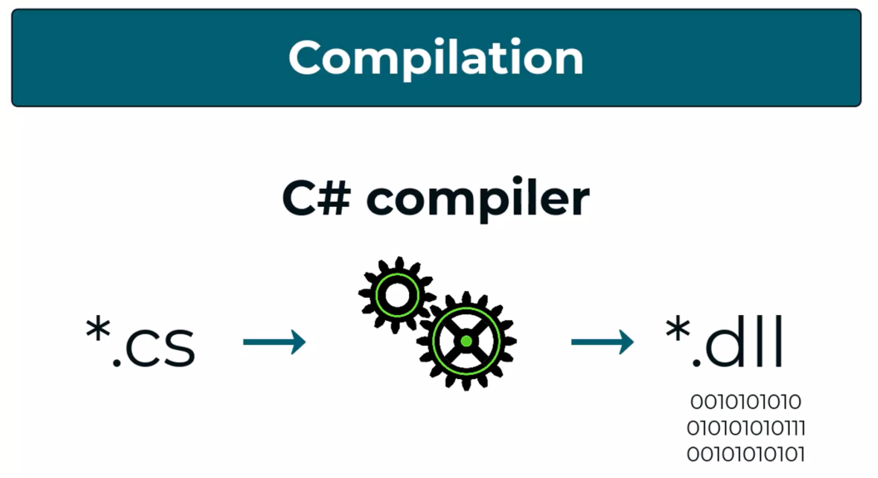
Text file to .exe

Slide 3

The most important skill

Slide 4
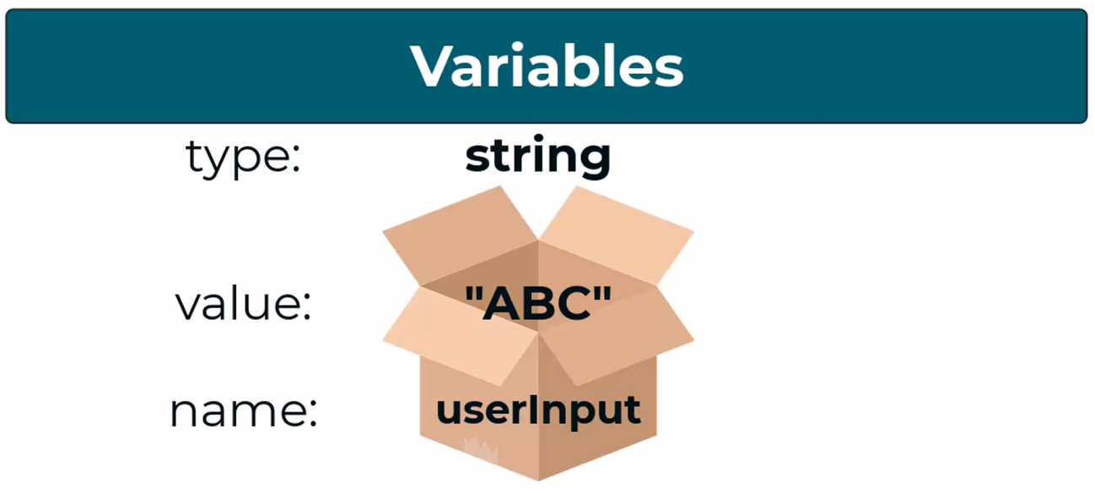
Variables

Slide 5
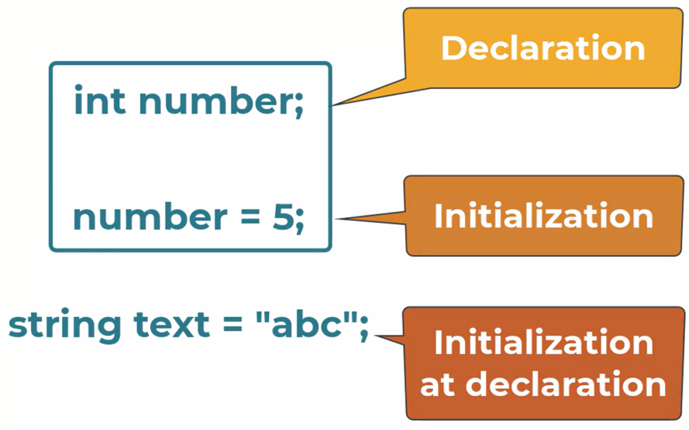
Variables

Slide 6
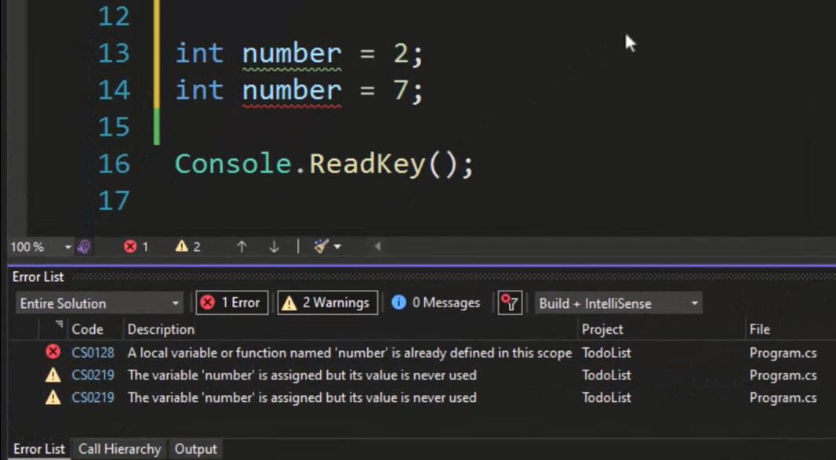
variables

Slide 7
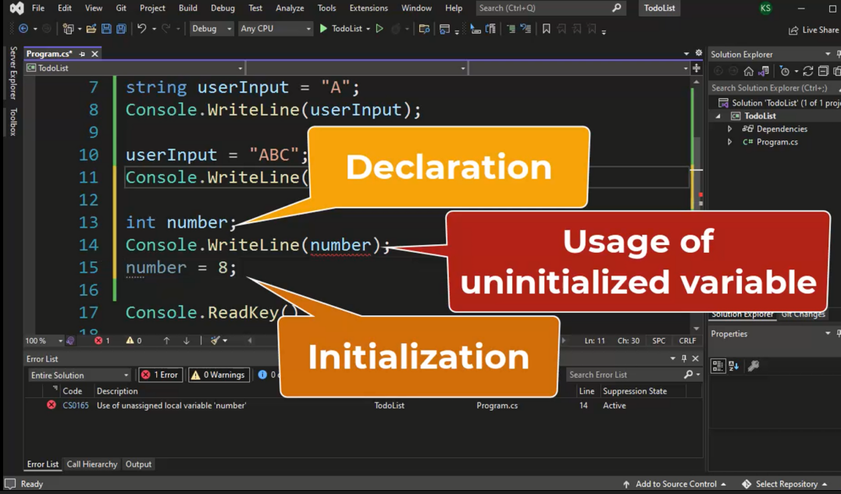
variables

Slide 8
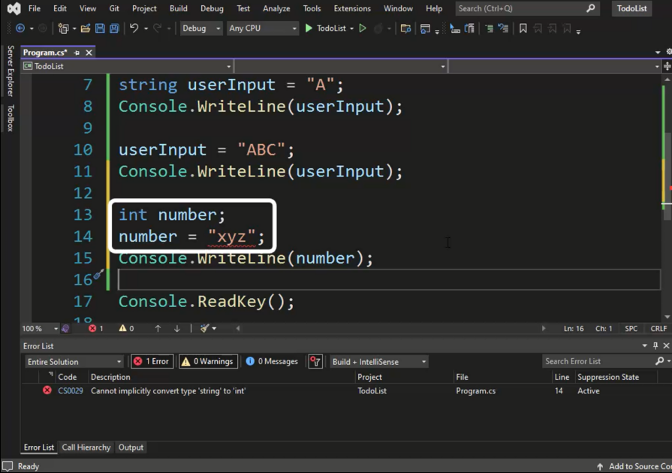
variables

Slide 9
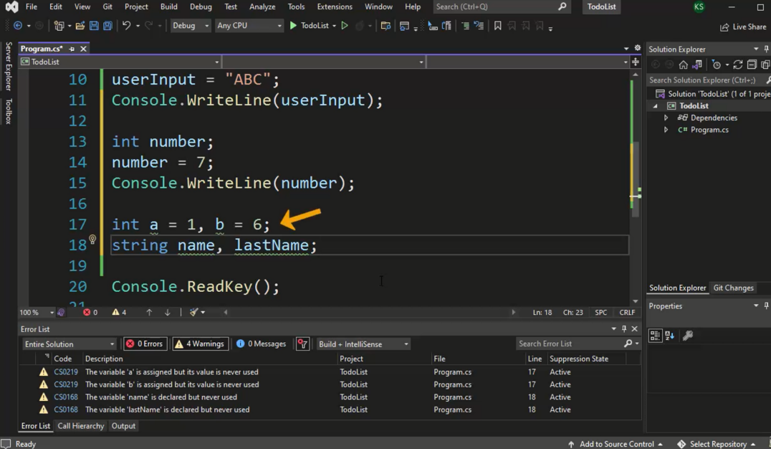
variables

Slide 10
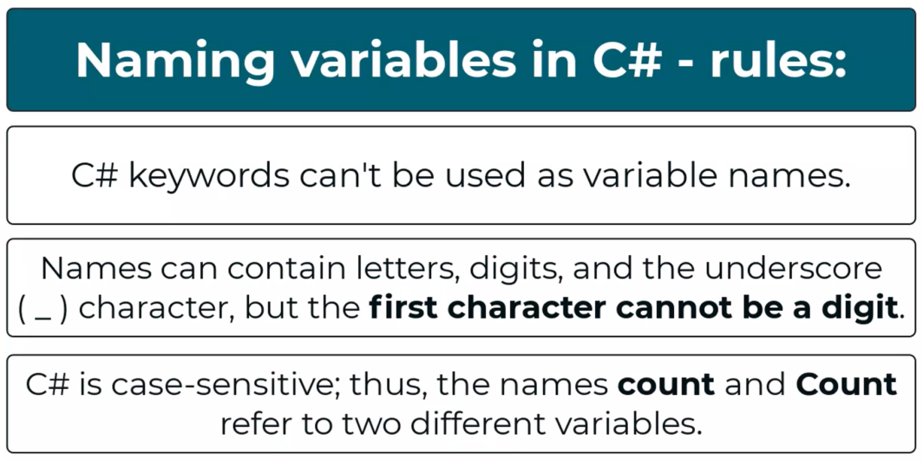
Naming
Notes:
https://learn.microsoft.com/en-us/dotnet/csharp/language-reference/keywords/

Slide 11
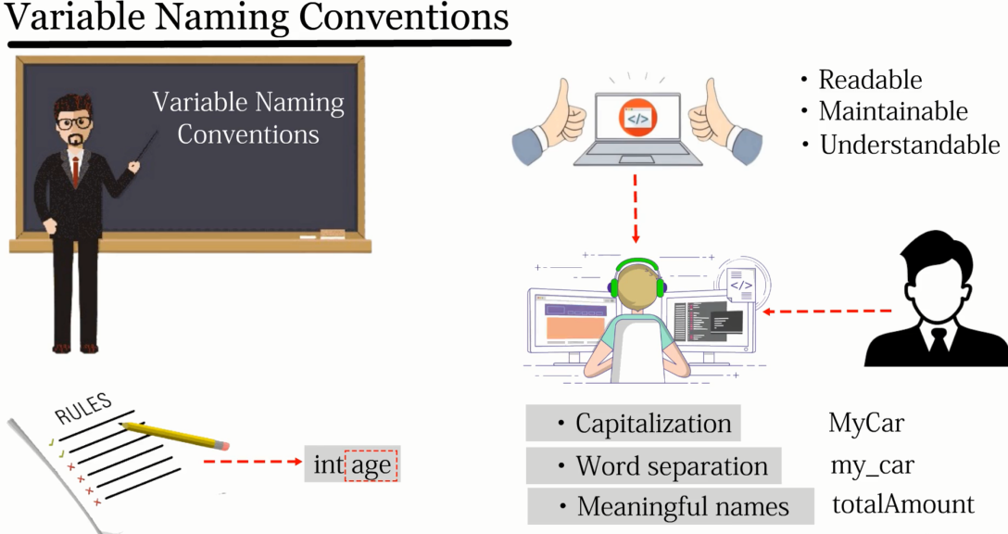
naming

Slide 12
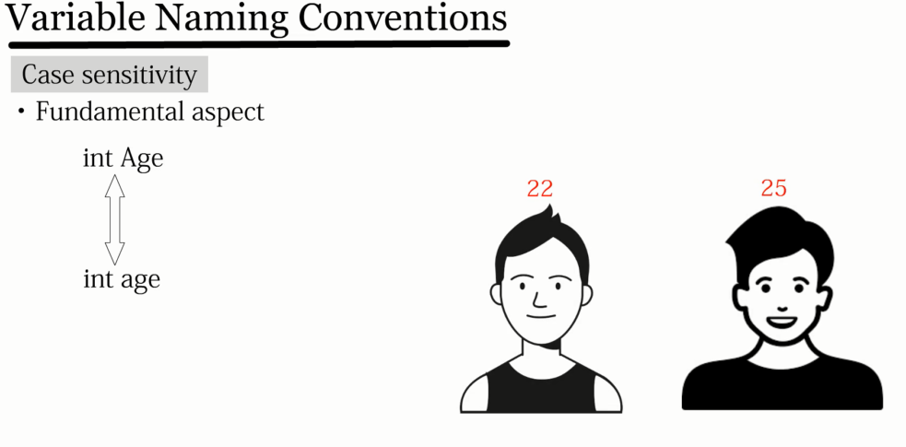
naming

Slide 13
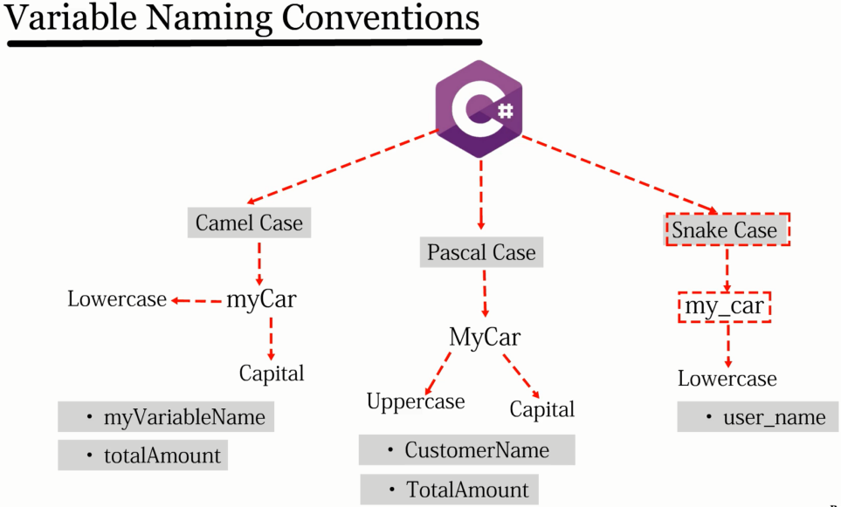
naming

Slide 14
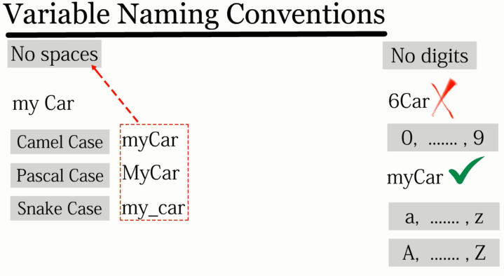
naming

Slide 15
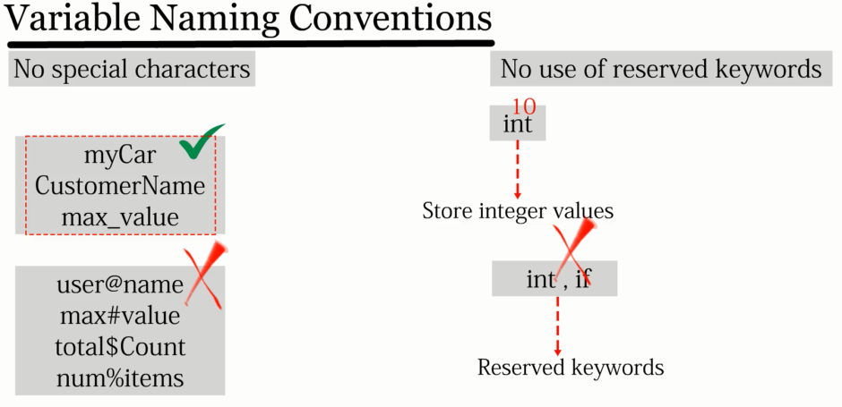
naming

Slide 16
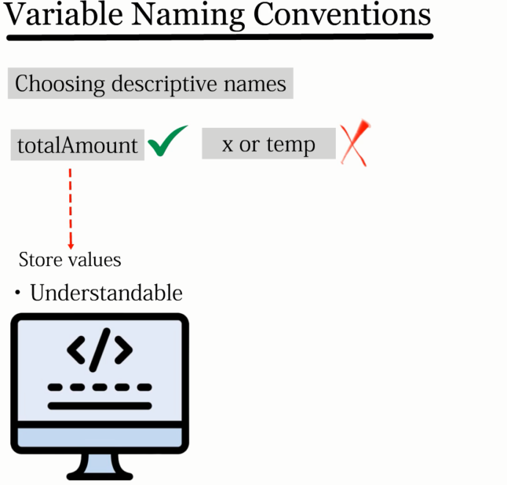
naming

Slide 17
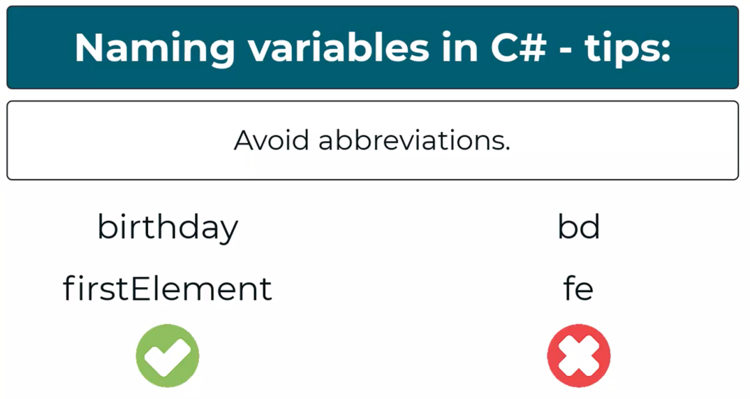
Naming tips

Slide 18
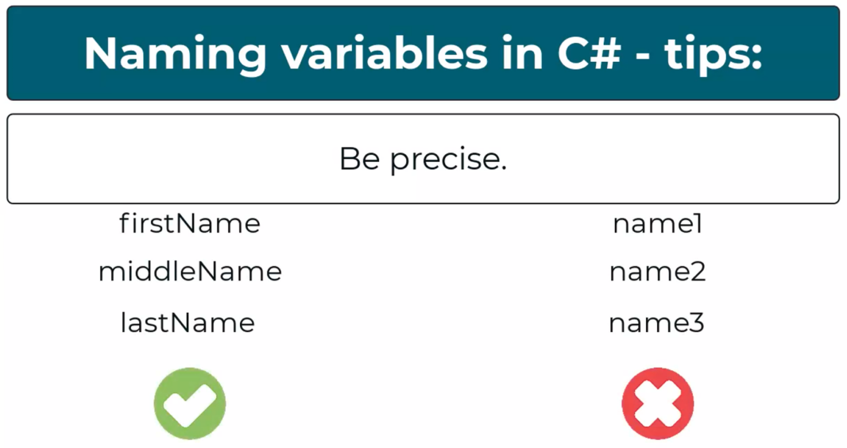
Naming tips

Slide 19
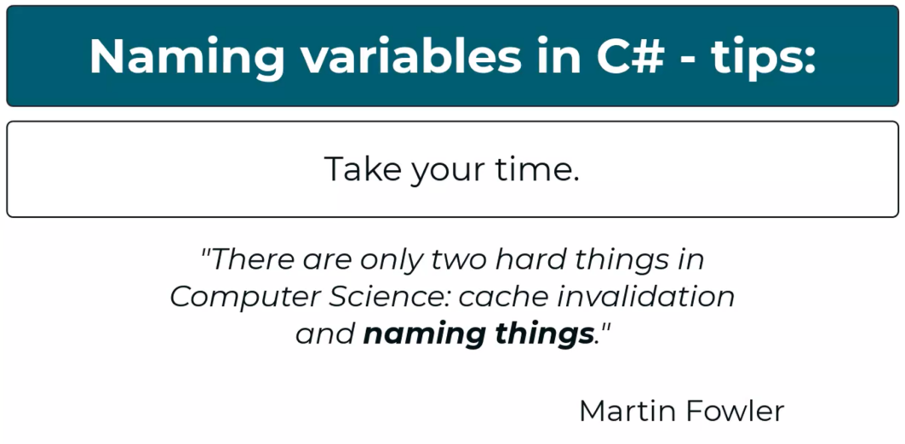
Naming tips

Slide 20
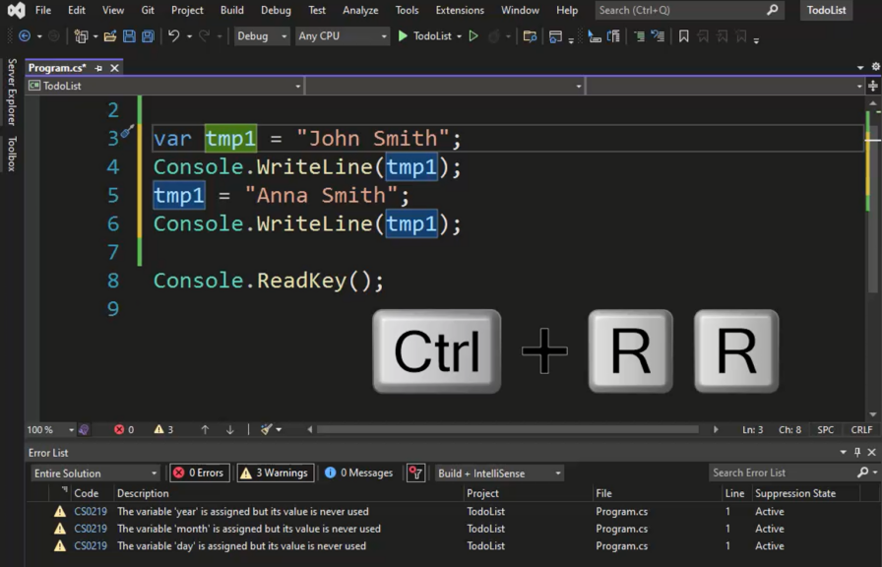
rename

Slide 21
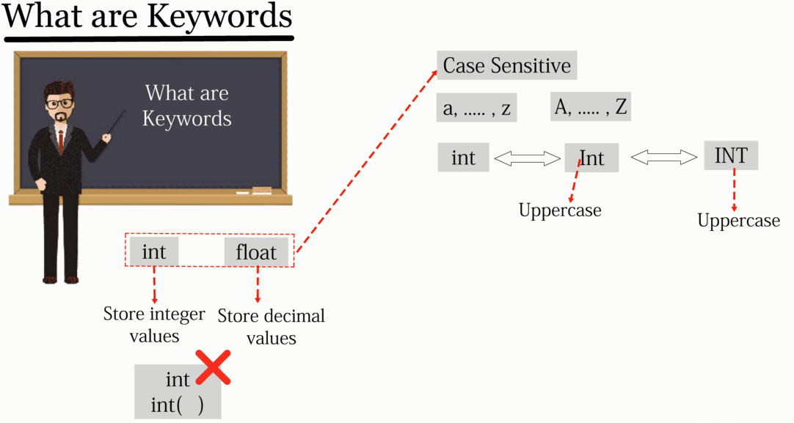
keywords

Slide 22
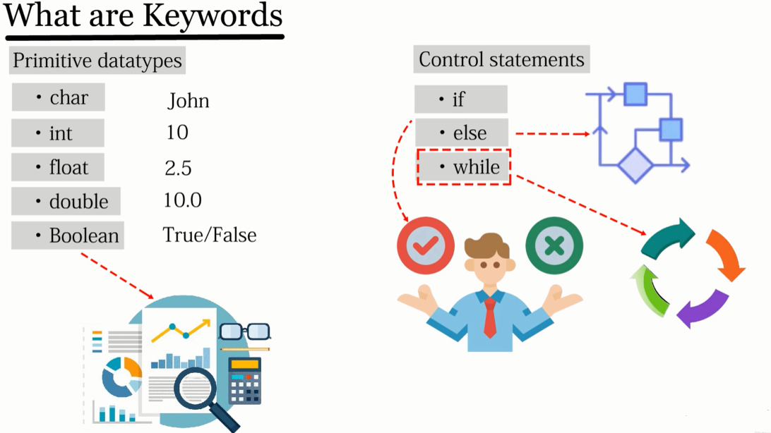
keywords

Slide 23
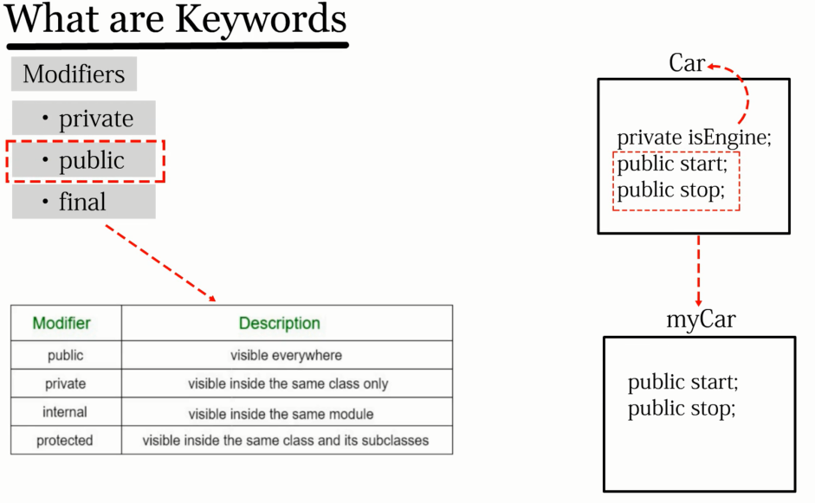
keywords

Slide 24
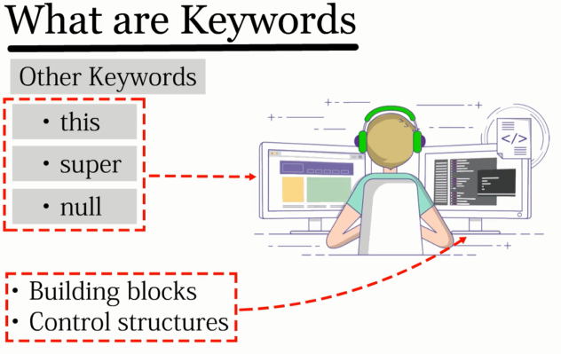
keywords
Notes:
https://learn.microsoft.com/en-us/dotnet/csharp/language-reference/keywords/

Slide 25
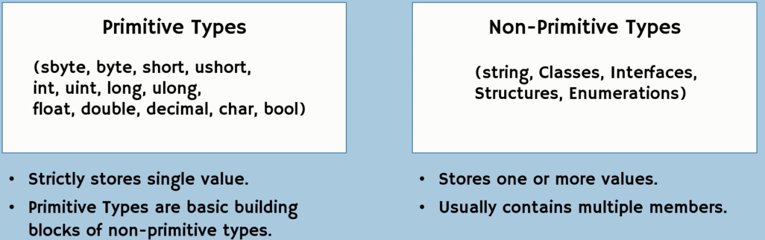
Variables – types and ranges

Slide 26
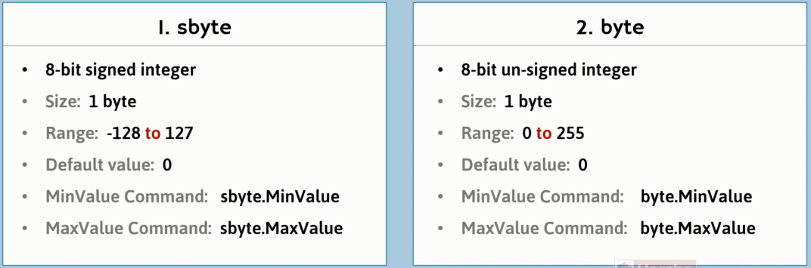
Variables – types and ranges

Slide 27
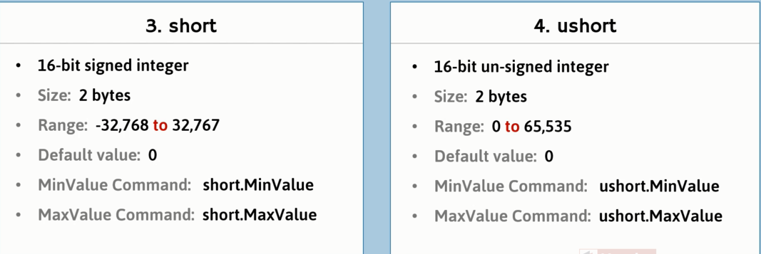
Variables – types and ranges

Slide 28
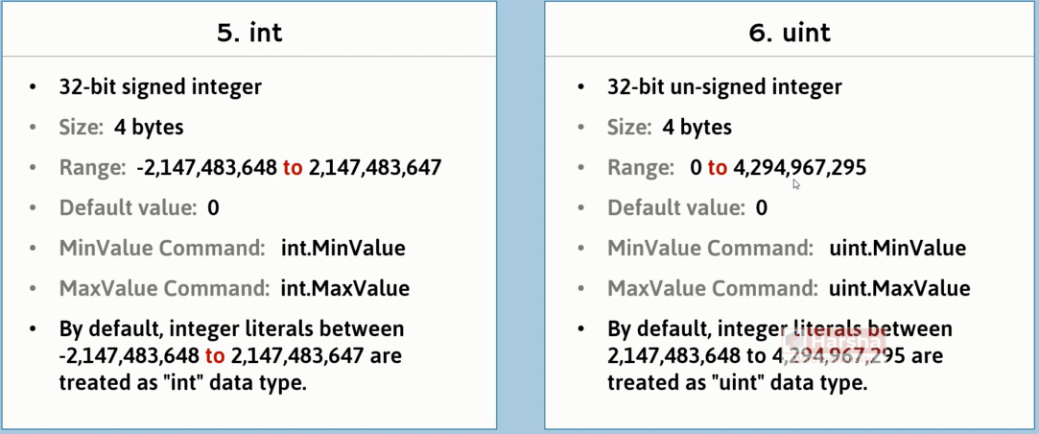
Variables – types and ranges

Slide 29
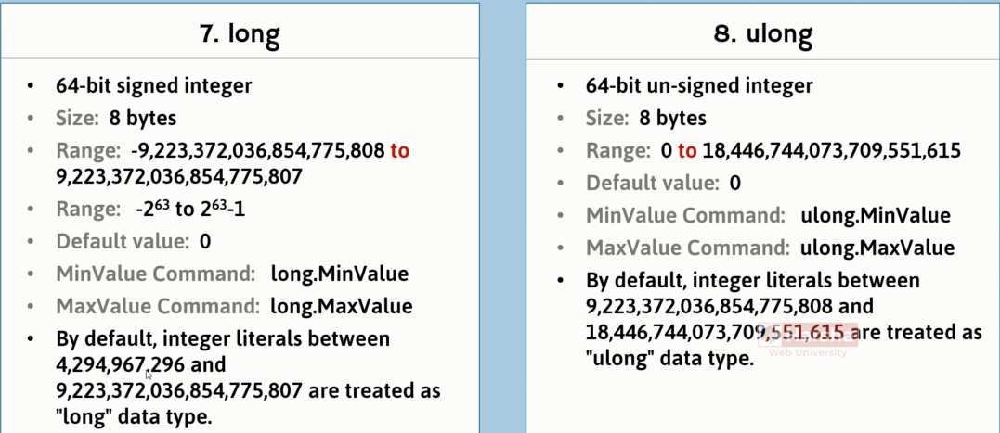
Variables – types and ranges

Slide 30
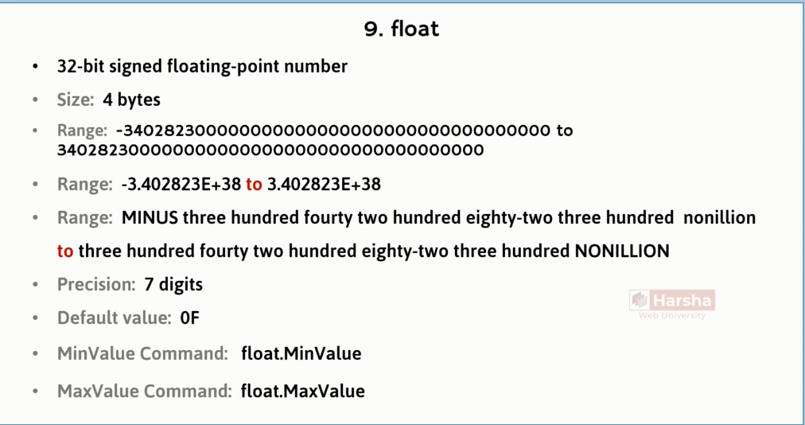
Variables – types and ranges

Slide 31
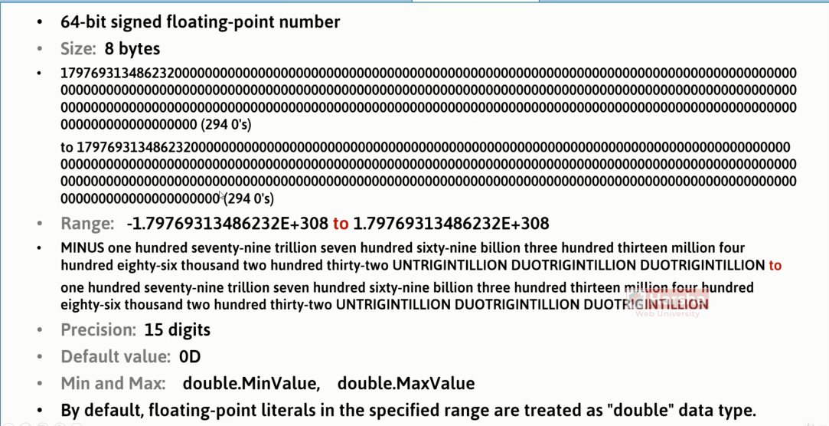
Variables – types and ranges

Slide 32
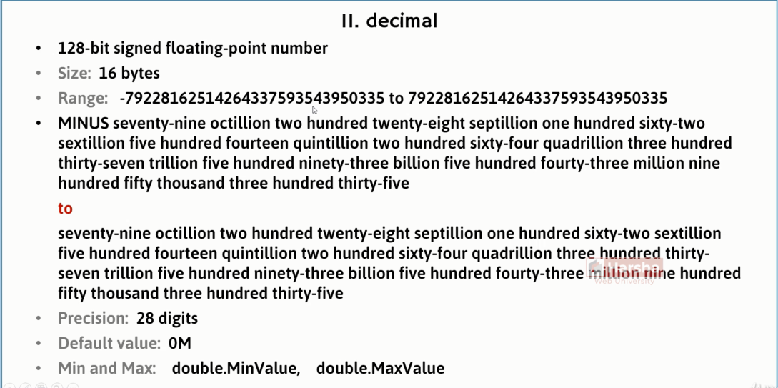
Variables – types and ranges

Slide 33
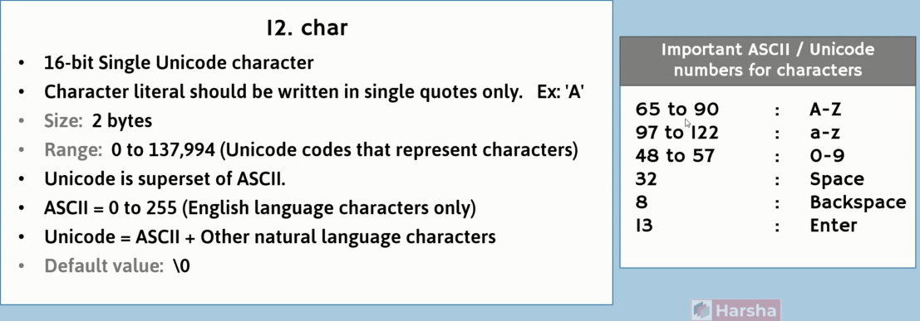
Variables – types and ranges

Slide 34
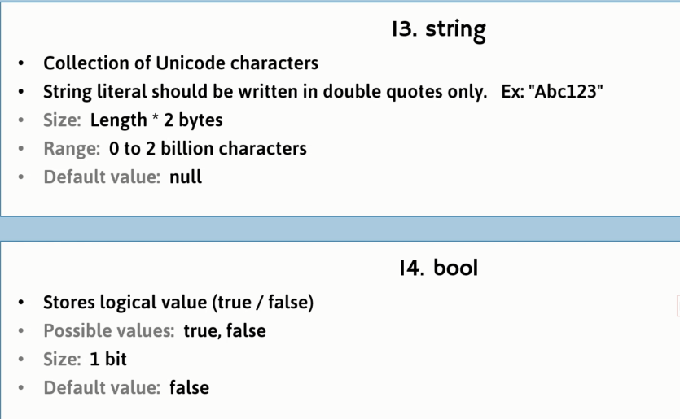
Variables – types and ranges

Slide 35
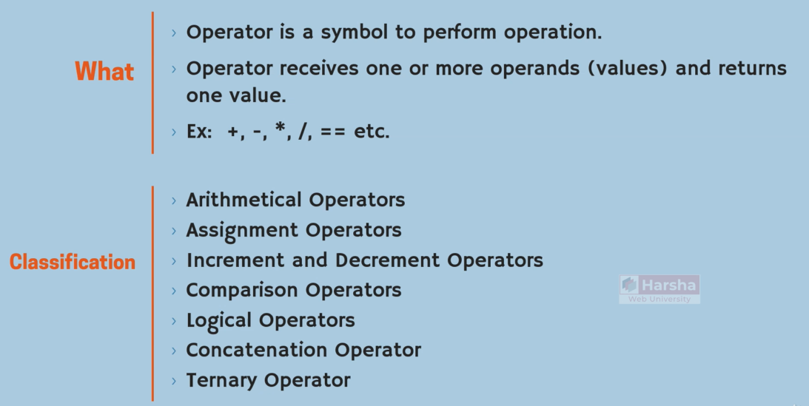
operators

Slide 36
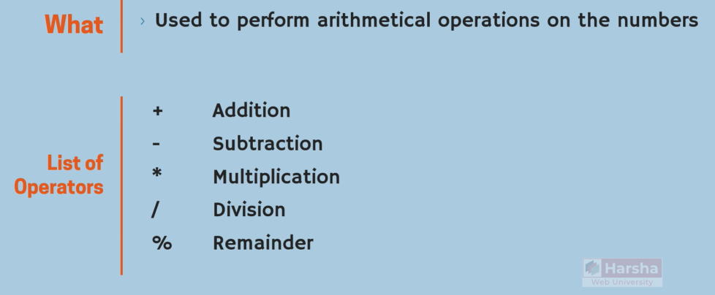
Operators - arithmatic

Slide 37
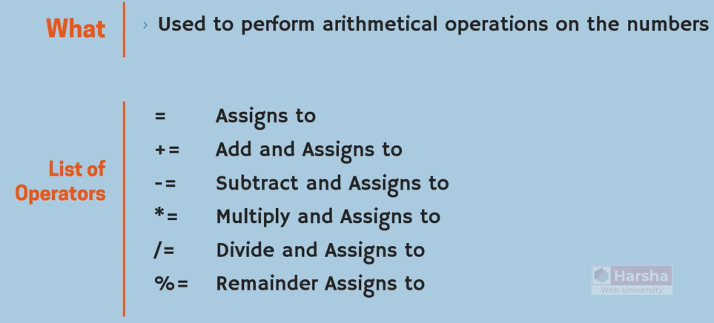
Operators - assignment

Slide 38
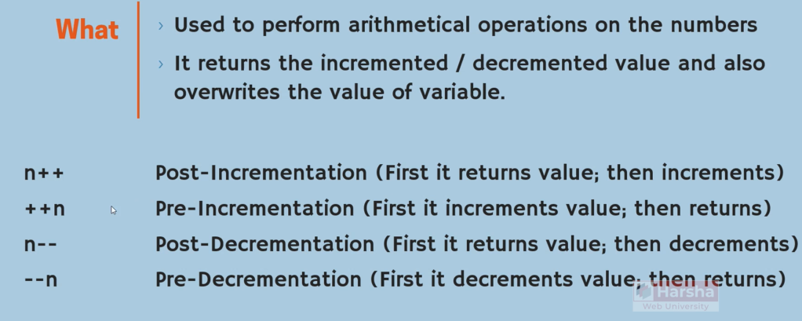
Operators - increment

Slide 39
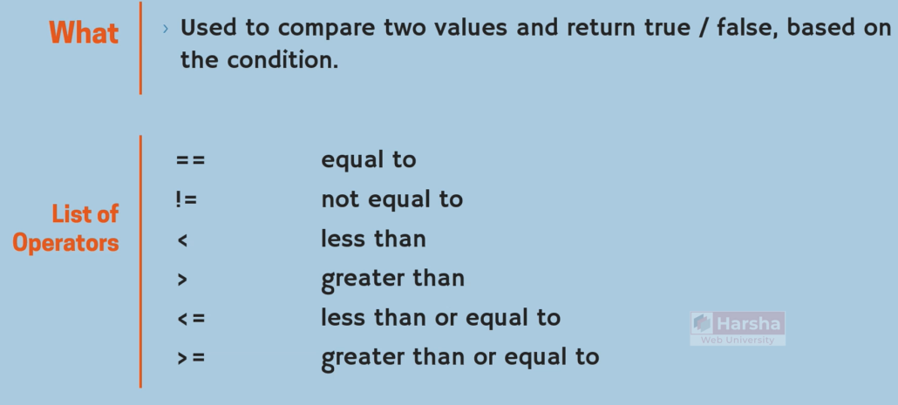
Operators - comparison

Slide 40
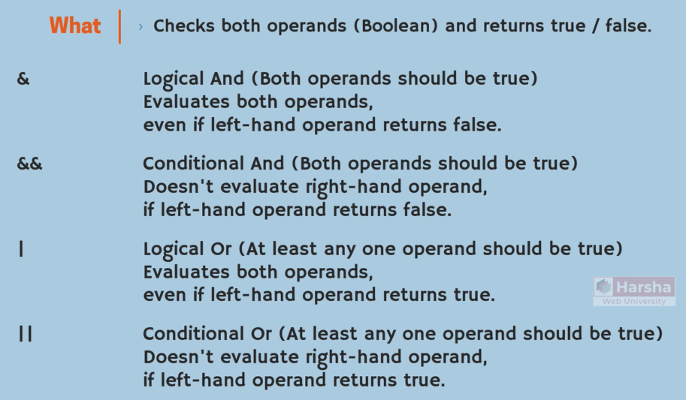
Operators - logical

Slide 41

Operators - logical

Slide 42
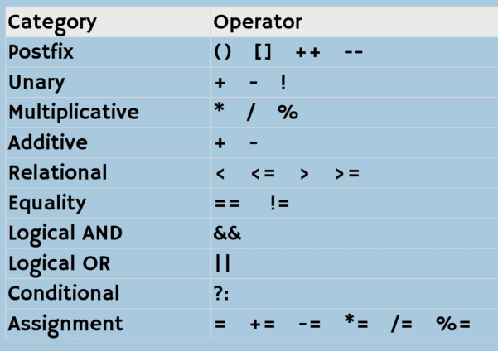
Operators – precedence

Slide 43
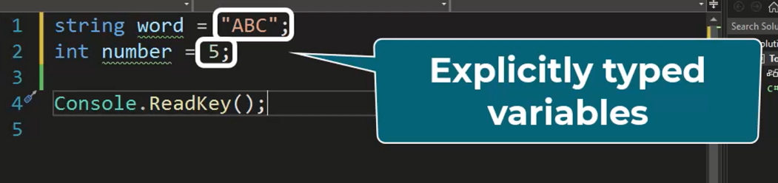
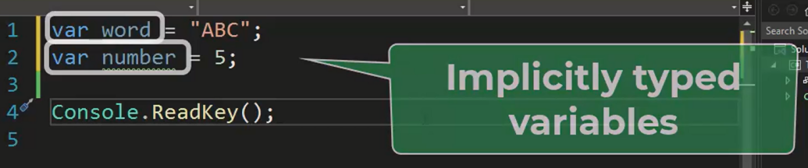
Variables – implicitly & explicitly
Notes:
1- After initialization they can’t be changed.
2- They must be initialized.

Slide 44
Debugging
Breakpoint: for stopping execution on the desired line.
Step over: Line by line – procedures single line
Step into: Line by line
Step out: come back from the procedure
Quick watch: watch variables

